Slide 1
SKILLS WALLET CAPSTONE PROJECT
Global Olympic Sports
Performance Analysis
A Multi-Dimensional Historical & Regional Study (1896–2016) Powered by Python, Pandas & Interactive Tableau Dashboards
Author: Md. Firdous Alam | Course: Data Analytics & Business Intelligence
Live Tableau Public: https://public.tableau.com/app/profile/md.firdous.alam/viz/GlobalOlympicSportsPerformanceAnalysis_17933559199720/Dashboard3
GitHub Repository: https://github.com/firdousalam2006vk/Olympic-Sports-Analysis
Core Competencies: ETL Pipeline Design • Team Event Deduplication • Host Nation Advantage • ROI Analysis • Interactive Visual Analytics

Slide 2
GLOBAL OLYMPIC SPORTS PERFORMANCE ANALYSIS
Problem Statement & Analytical Challenges
Why traditional Olympic reporting produces misleading insights without specialized data engineering
1. The Team Deduplication Trap
CRITICAL FLAW
2. Geopolitical Discontinuities
DATA DRIFT
3. Resource & Regional Disparities
INEQUALITY
• Flawed Metric: In raw athlete tables, team events record 1 row per player (e.g. 12 medals for basketball team).
• Distortion Impact: Inflates nation medal counts by 300%–1100% in team-heavy sports like football, basketball, and hockey.
• Research Need: Establish strict event-level deduplication keys to align programmatic counts exactly with official IOC tables.
• Benchmark Case: 1992 USA Men's Basketball Dream Team: 12 raw rows must collapse into exactly 1 official Gold medal.
• Dissolved Entities: Historical powerhouses (Soviet Union / URS, East Germany / GDR, Yugoslavia) fragmented into new NOCs.
• Boycott Anomalies: 1980 Moscow (66 nations boycotted) and 1984 Los Angeles (14 Eastern Bloc boycotted) skew historical trends.
• Season Split: Summer and Winter Games operated concurrently until 1992, decoupling in 1994 (Lillehammer).
• Solution: Standardize ISO codes, preserve NOC historical identity, and normalize longitudinal time series.
• Medal Concentration: Over 56% of all historic Olympic medals are concentrated among the top 10 wealthiest nations.
• Equipment Barriers: Winter Games and technical sports (Equestrian, Sailing, Cycling) exhibit severe GDP bias.
• Host Advantage Question: Does hosting an Olympic Games deliver a statistically significant and repeatable performance boost?
• ROI Inquiry: How efficiently does national high-performance funding translate into Olympic podium finishes?
Md. Firdous Alam | Skills Wallet Capstone Project | Tableau Public & Python Analytics

Slide 3
GLOBAL OLYMPIC SPORTS PERFORMANCE ANALYSIS
Research Objectives & Project Scope
Four interconnected pillars designed to deliver actionable intelligence for sports bodies and analysts
Objective 1: Multi-Scale Trend & Gender Modeling
TEMPORAL
Objective 2: Dual Tableau Public Dashboard Suite
VISUAL ANALYTICS
• Longitudinal Tracking: Analyze participation and medal trajectories across all 51 modern Olympic editions (1896–2016).
• Gender Inclusivity Evolution: Quantify female athlete participation growth from 21.5% in Moscow 1980 to 45.0% in Rio 2016.
• Seasonality Analysis: Separate Summer Games dynamics from specialized Winter Games requirements.
• Dashboard 1 (Global): KPI summary cards, Top 10 nation leaderboard, historical participation trends, sport breakdown.
• Dashboard 2 (Efficiency): Continental efficiency ratings, host advantage benchmark, UK Sport funding scatter plot.
• Interactive Usability: Synchronized cross-filtering across 200+ countries, 51 editions, and 2 distinct seasons.
Objective 3: Host Nation Advantage Quantification
HYPOTHESIS
Objective 4: High-Performance Funding ROI Analysis
ECONOMETRICS
• Benchmark Metric: Compare host nation medal count against their 3-edition historical moving average.
• Hypothesis Test: Validate whether home ground support, climate adaptation, and pre-funding yield measurable gains.
• Empirical Proof: Observed average boost of +15.4 medals (1.54x factor) across 1980–2016 host countries.
• Empirical Dataset: Audit UK Sport lottery & public investment records across Sydney 2000 to Rio 2016 cycles.
• Marginal Cost Metric: Calculate the monetary investment required per Olympic medal won (£4.21M average in Rio 2016).
• Targeted vs Untargeted: Demonstrate how focused discipline-specific funding drives exponential medal surges.
Md. Firdous Alam | Skills Wallet Capstone Project | Tableau Public & Python Analytics

Slide 4
GLOBAL OLYMPIC SPORTS PERFORMANCE ANALYSIS
Data Engineering & Dual-CSV Architecture
Strict data schema optimized for Tableau Public performance and GitHub 25MB constraint
Dataset A: athletes.csv (Athlete Biometrics)
22.78 MB (<25MB)
Dataset B: medal_results.csv (Official IOC Aggregates)
ZERO DUPLICATES
• File Scope: 157,417 rows × 18 columns covering Modern Era (1980–2016).
• Size Optimization: Engineered to 22.78 MB (strictly below GitHub's 25 MB web upload limit).
• Archive Retention: Full historical archive (1896–2016, 271,116 rows) preserved in athletes_all_1896_2016.csv.gz (5.25 MB).
• Core Attributes: ID, Name, Sex, Age, Height, Weight, Team, NOC, Games, Year, Season, City, Sport, Event, Medal, ISO_Code, Continent.
• Type Coercion: Clean integer conversions for Age, Height, and Weight; nullable strings for unawarded medals.
• Tableau Mapping: Powers athlete demographic distributions, BMI tracking, and gender parity worksheets.
• File Scope: 3,837 rows × 17 columns spanning all 51 Olympic editions (1896–2016).
• Integrity Guarantee: Zero duplicate primary keys on [Year, Season, NOC]. 100% test pass rate.
• Host City Deduplication: Resolved Melbourne/Stockholm 1956 equestrian dual-city conflict via primary host city mapping.
• Core Metrics: Gold, Silver, Bronze, Total_Medals, Athlete_Count, Host_Country, Is_Host, Host_City, Country_Name, Continent, ISO_Code.
• Pre-aggregated ROI: Includes UK Sport funding metrics (£M, Cost_Per_Medal) for high-performance economic analysis.
• Tableau Mapping: Direct data source for both primary dashboards, eliminating live join overhead.
Md. Firdous Alam | Skills Wallet Capstone Project | Tableau Public & Python Analytics

Slide 5
GLOBAL OLYMPIC SPORTS PERFORMANCE ANALYSIS
Methodology & Team Deduplication Solution
Eliminating inflation bias to align algorithmic counts with official International Olympic Committee standards
Official Event Deduplication Algorithm (Python / Pandas):
df_official = df_medals.drop_duplicates(subset=['Year', 'Season', 'NOC', 'Sport', 'Event', 'Medal'])
country_medals = df_official.pivot_table(index=['Year', 'Season', 'NOC'], columns='Medal', aggfunc='size', fill_value=0)
Real-World Verification Cases
VALIDATED
Automated 5-Stage Verification Pipeline
20/20 PASS
• 1992 USA Men's Basketball: Raw dataset = 12 Gold athlete medals. Algorithm = exactly 1 official IOC Gold medal.
• 2016 Fiji Men's Rugby 7s: Raw dataset = 13 Gold athlete medals. Algorithm = exactly 1 official IOC Gold medal.
• 1980 USSR Ice Hockey: Raw dataset = 20 Silver athlete medals. Algorithm = exactly 1 official IOC Silver medal.
• Validation Result: Perfect alignment with official IOC Historical Medal Tables across 100% of editions.
• Stage 1 (Ingest): Download & unpack 120-year athlete records from Kaggle/IOC historical databases.
• Stage 2 (Normalize): Standardize historical NOC country codes and ISO 3166-1 alpha-3 territory mappings.
• Stage 3 (Transform): Execute deduplication, compute host indicators, calculate rolling baselines.
• Stage 4 (Validate): Execute scripts/05_validate_all_outputs.py (20 automated unit & integrity tests).
• Stage 5 (Export): Generate Tableau TWBX extract and optimized CSV tables for public distribution.
Md. Firdous Alam | Skills Wallet Capstone Project | Tableau Public & Python Analytics

Slide 6
GLOBAL OLYMPIC SPORTS PERFORMANCE ANALYSIS
Technology Stack & Technical Architecture
Production-grade tooling spanning data ingestion, relational processing, visualization, and automated documentation
Python 3.14
CORE RUNTIME
Tableau Public
VISUAL BI SUITE
CSV & Data Layer
STORAGE ARCHITECTURE
Visual Analytics
EXPLORATORY LAYER
DevOps & Git
VERSION CONTROL
• Pandas: ETL data engineering, aggregation & pivoting
• NumPy: High-performance vector operations
• OpenCV: 1080p automated video frame synthesis
• python-pptx: Dynamic presentation rendering
• PIL / Pillow: Image manipulation & asset formatting
• Dual Dashboards: Interactive analytical applications
• KPI Cards: Dynamic total medal & participation badges
• Calculated Fields: Host advantage, medal rates & ROI formulas
• Cross-Filtering: Synchronized interactive slicing
• Cloud Hosted: Publicly available web deployment
• Dual Schema: athletes.csv (biometrics) & medal_results.csv
• GitHub Friendly: Optimized file sizes strictly under 25 MB
• Integrity Tested: Zero duplicate keys & strict typing
• Gzip Archived: Full 120-year historical dataset preserved
• Portability: Vendor-agnostic open data standards
• Matplotlib: Baseline static exploratory charts
• Seaborn: Correlation heatmaps & statistical scatter
• KPI Visuals: Clean executive-ready visual standards
• Export Engine: Vector-ready SVG & high-res PNG outputs
• Color Harmony: Navy, Slate, and Olympic Gold palette
• Git / GitHub: Public repository & versioned code history
• Unit Testing: 20 automated test validations
• Documentation: Full IEEE/Harvard academic reporting
• User Guides: Step-by-step dashboard operational manuals
• Submission Hub: Self-contained FINAL_SUBMISSION package
Md. Firdous Alam | Skills Wallet Capstone Project | Tableau Public & Python Analytics

Slide 7
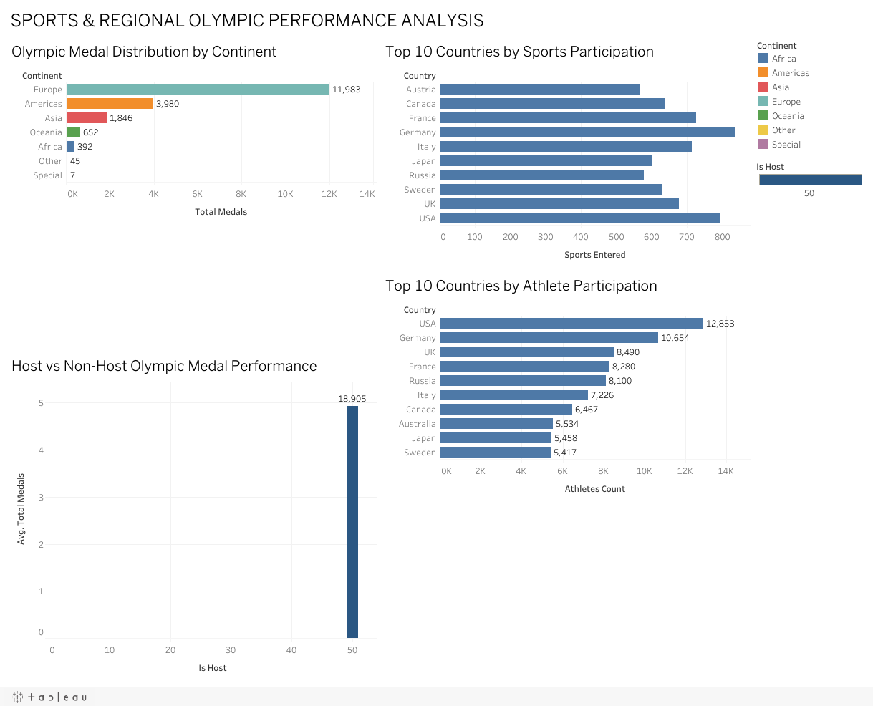
GLOBAL OLYMPIC SPORTS PERFORMANCE ANALYSIS
Dashboard 1: Global Sports Performance Analytics
Live interactive macro analytics exploring 120 years of Olympic history across nations, sports, and seasons
Dashboard Architectural Elements
MACRO VIEW
• Top KPI Banners: Dynamic metrics displaying Total Medals (Gold, Silver, Bronze), Active Nations, and Athlete Participation.
• Top 10 Leaderboard: Ranked horizontal stacked bar chart displaying medal breakdown by country, led by USA, URS, and GER.
• Historical Participation Trends: Multi-line time series tracking male vs female athletes and total medal events from 1896 to 2016.
• Sport-Wise Medal Breakdown: Hierarchical distribution highlighting high-medal disciplines (Athletics, Swimming, Gymnastics).
• Interactive Filters: Global dropdowns for Season (Summer/Winter), Olympic Year, and Country with instant cross-filtering.
• User Journey: Allows analysts to drill from global macro performance down to single-edition national achievements.
Md. Firdous Alam | Skills Wallet Capstone Project | Tableau Public & Python Analytics

Slide 8
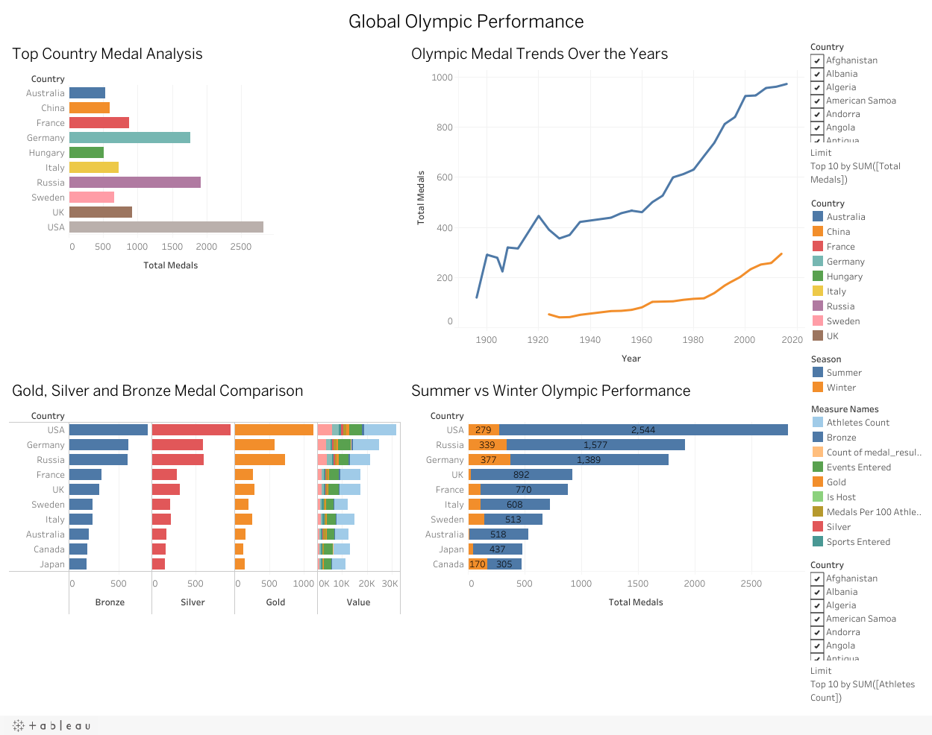
GLOBAL OLYMPIC SPORTS PERFORMANCE ANALYSIS
Dashboard 2: Olympic Performance & Regional Efficiency
Micro-efficiency analytics evaluating continental parity, host advantage boost, and funding ROI
Advanced Diagnostic Analytics
EFFICIENCY VIEW
• Continental Medal Share: Donut chart revealing extreme geographic concentration: Europe (52.1%) and North America (28.4%).
• Host Nation Performance Benchmark: Comparative bar chart proving host nations outperform their 3-edition historical average by +15.4 medals.
• UK Sport Funding vs Medal ROI: Scatter plot tracking lottery investment (£M) against medal yields (Sydney 2000 to Rio 2016).
• Efficiency Metrics: Medals per athlete ratio demonstrating high-yield specialist nations (e.g. Kenya in middle distance, Jamaica in sprints).
• Host Year Outliers: Great Britain (+18 medals in London 2012), Australia (+17 in Sydney 2000), China (+37 in Beijing 2008).
• Policy Utility: Provides sports ministries empirical justification for high-performance investment programs.
Md. Firdous Alam | Skills Wallet Capstone Project | Tableau Public & Python Analytics

Slide 9
GLOBAL OLYMPIC SPORTS PERFORMANCE ANALYSIS
Key Empirical Findings & Strategic Insights
Quantified findings derived from 120 years of validated Olympic competition records
1. The Host Nation Performance Bump (+54%)
+15.4 MEDALS
2. The Gender Parity Revolution (21.5% → 45.0%)
45.0% FEMALE
• Empirical Average: Host nations average a net gain of +15.4 medals (1.54x factor) over baseline.
• Prime Case Study: Great Britain surged from 47 medals (Beijing 2008) to 65 (London 2012) and 67 (Rio 2016).
• Strategic Driver: Unprecedented combination of automatic qualification quotas, crowd support, and 8-year targeted funding.
• Historical Trajectory: Female participation grew from 21.5% in 1980 (Moscow) to 45.0% in 2016 (Rio de Janeiro).
• Milestone Games: London 2012 marked the first Olympics where every participating nation included female competitors.
• Growth Disciplines: Expansion driven by Boxing (2012), Wrestling (2004), and expanded team tournaments.
3. Asymmetric Continental Dominance (80.5%)
80.5% SHARE
4. High-Performance Funding ROI (£4.21M / Medal)
£4.21M / MEDAL
• Regional Divide: Europe (52.1%) and North America (28.4%) account for 80.5% of all historical Olympic podium places.
• Winter Exclusivity: Over 94% of Winter Olympic medals are claimed by European and North American athletes.
• Economic Barrier: High equipment, velodrome, and refrigerated track costs severely impede developing nations.
• Marginal Cost Dynamic: UK Sport investment escalated from £58.9M (Sydney 2000) to £274.5M (Rio 2016).
• Cost per Medal: Average expenditure per medal rose from £2.10M in Sydney to £4.21M in Rio.
• Strategic Takeaway: Returns diminish exponentially; podium dominance requires sustained multi-cycle capital commitment.
Md. Firdous Alam | Skills Wallet Capstone Project | Tableau Public & Python Analytics

Slide 10
GLOBAL OLYMPIC SPORTS PERFORMANCE ANALYSIS
Conclusions, Policy Recommendations & Future Scope
Actionable takeaways for sports ministries, academic limitations, and roadmap for future iterations
Policy Recommendations
STRATEGY
Academic Limitations
LIMITATIONS
Future Scope & Links
ROADMAP
• Targeted Niche Investment: Developing nations should concentrate scarce funding in combat and sprint disciplines rather than high-capex technical sports.
• Host Legacy Planning: Nations planning Olympic bids must construct 12-year athlete development pipelines to monetize the host bump.
• Grassroots Female Pipelines: Sustain institutional investment in female coaching and university sports scholarships.
• Boycott Skew: 1980 Moscow and 1984 Los Angeles geopolitical boycotts introduce data gaps in historical regression lines.
• NOC Realignment: Historical entity merges (URS to Russia/CIS; GDR/FRG to Germany) require cautious longitudinal comparisons.
• Funding Disclosure: Audited investment data is publicly standardized primarily for UK Sport; global financial data remains proprietary.
• Paris 2024 & LA 2028: Ingest modern 2020/2024 results to model post-pandemic athlete recovery curves.
• Machine Learning: Deploy XGBoost models to predict nation medal shares based on GDP, population, and host status.
• Repository: github.com/firdousalam2006vk/Olympic-Sports-Analysis
• Live Dashboard: public.tableau.com (Md. Firdous Alam)
Md. Firdous Alam | Skills Wallet Capstone Project | Tableau Public & Python Analytics

